Slide 1
Methylation of Monoallelic and Biallelic Colonies

Slide 2
Biallelic Colonies

Slide 3
1-3
CAST COLONIES 081015

Slide 4
1-6
CAST COLONIES 081015
9CG B6 COLONIES 081015

Slide 5
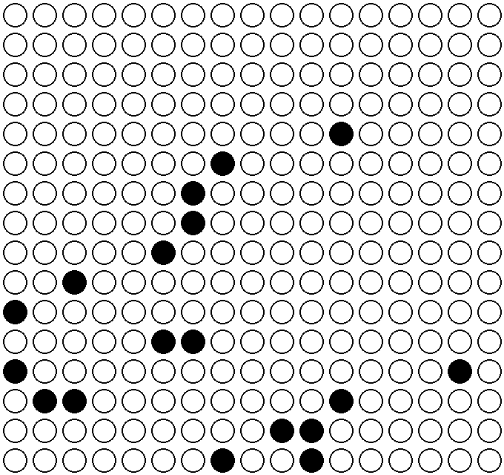
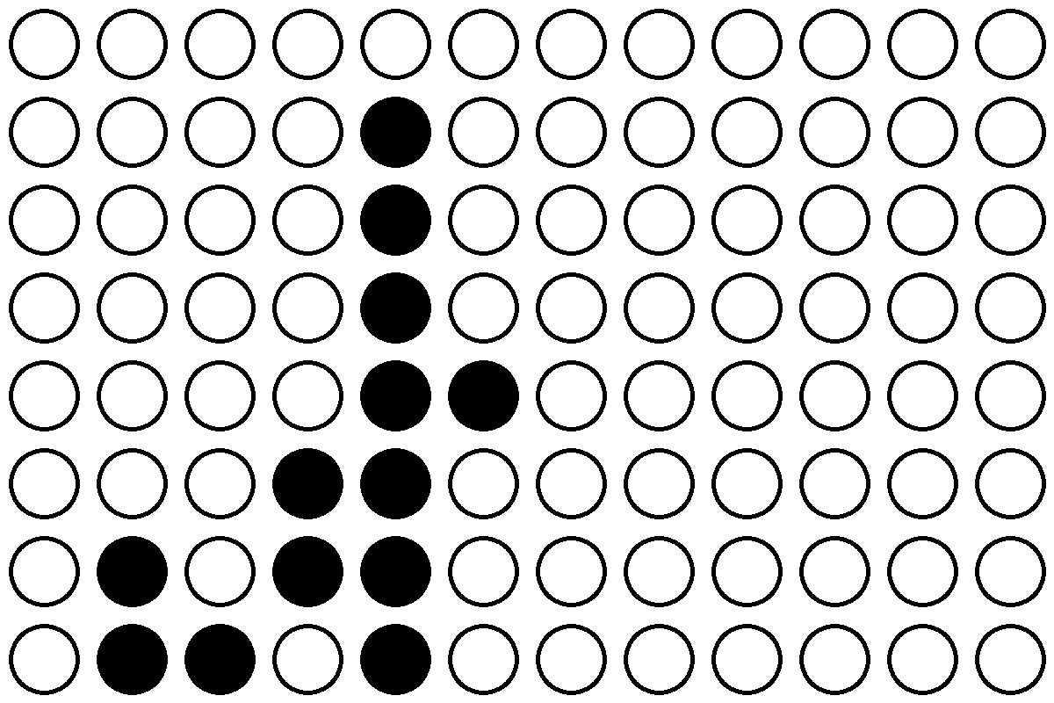
2-7
CAST COLONIES 050615, 051515,
080415, 081015
9CG B6 COLONIES 050615, 051515,
080415, 081015

Slide 6
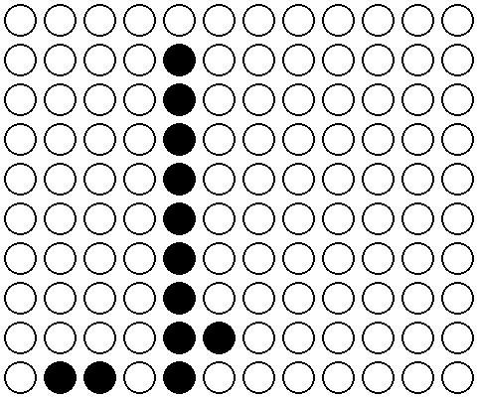



2-7 9CG B6 Individual
050515
080415
081015
051515

Slide 7
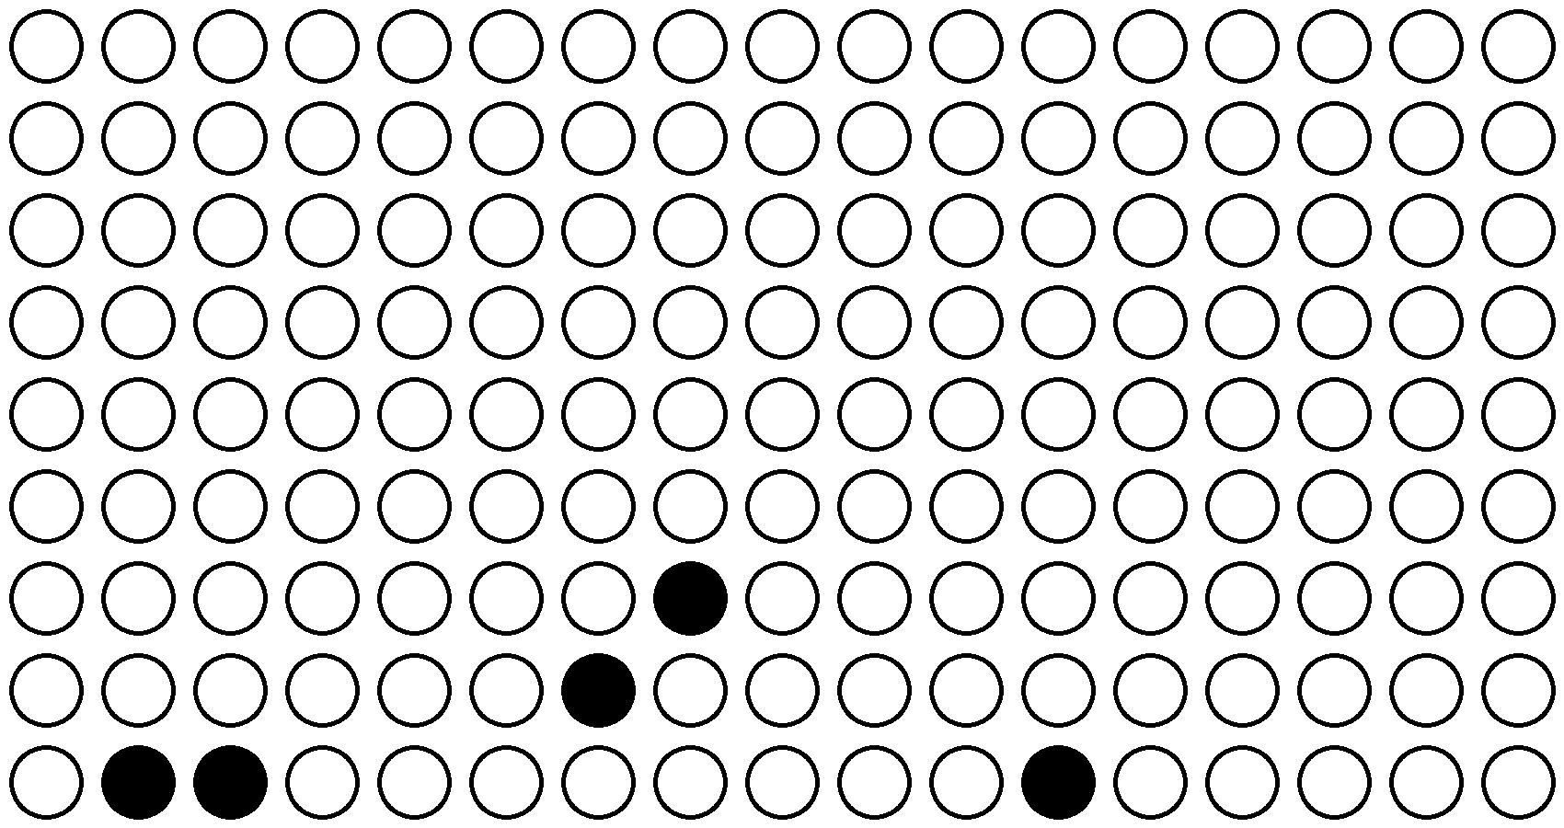
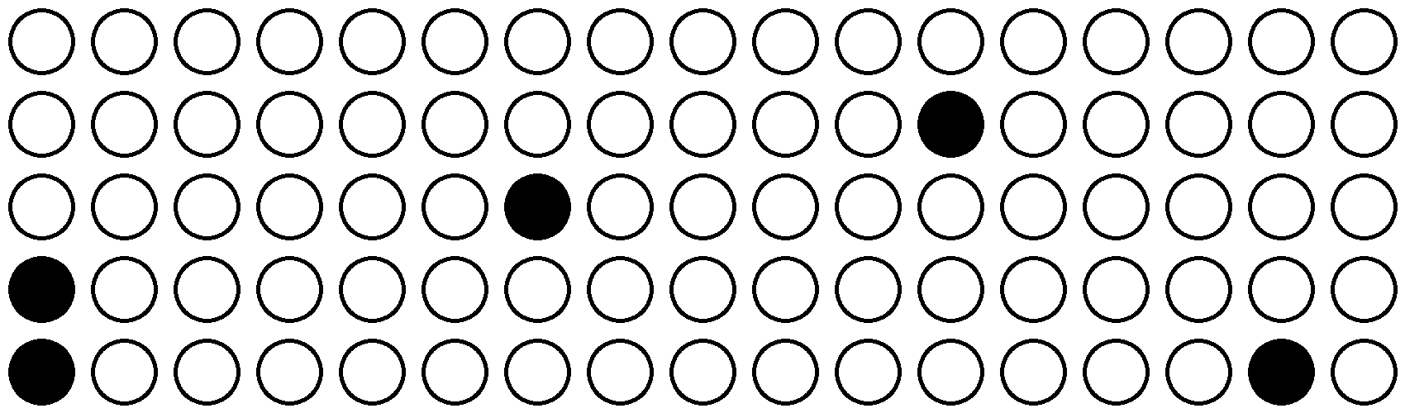
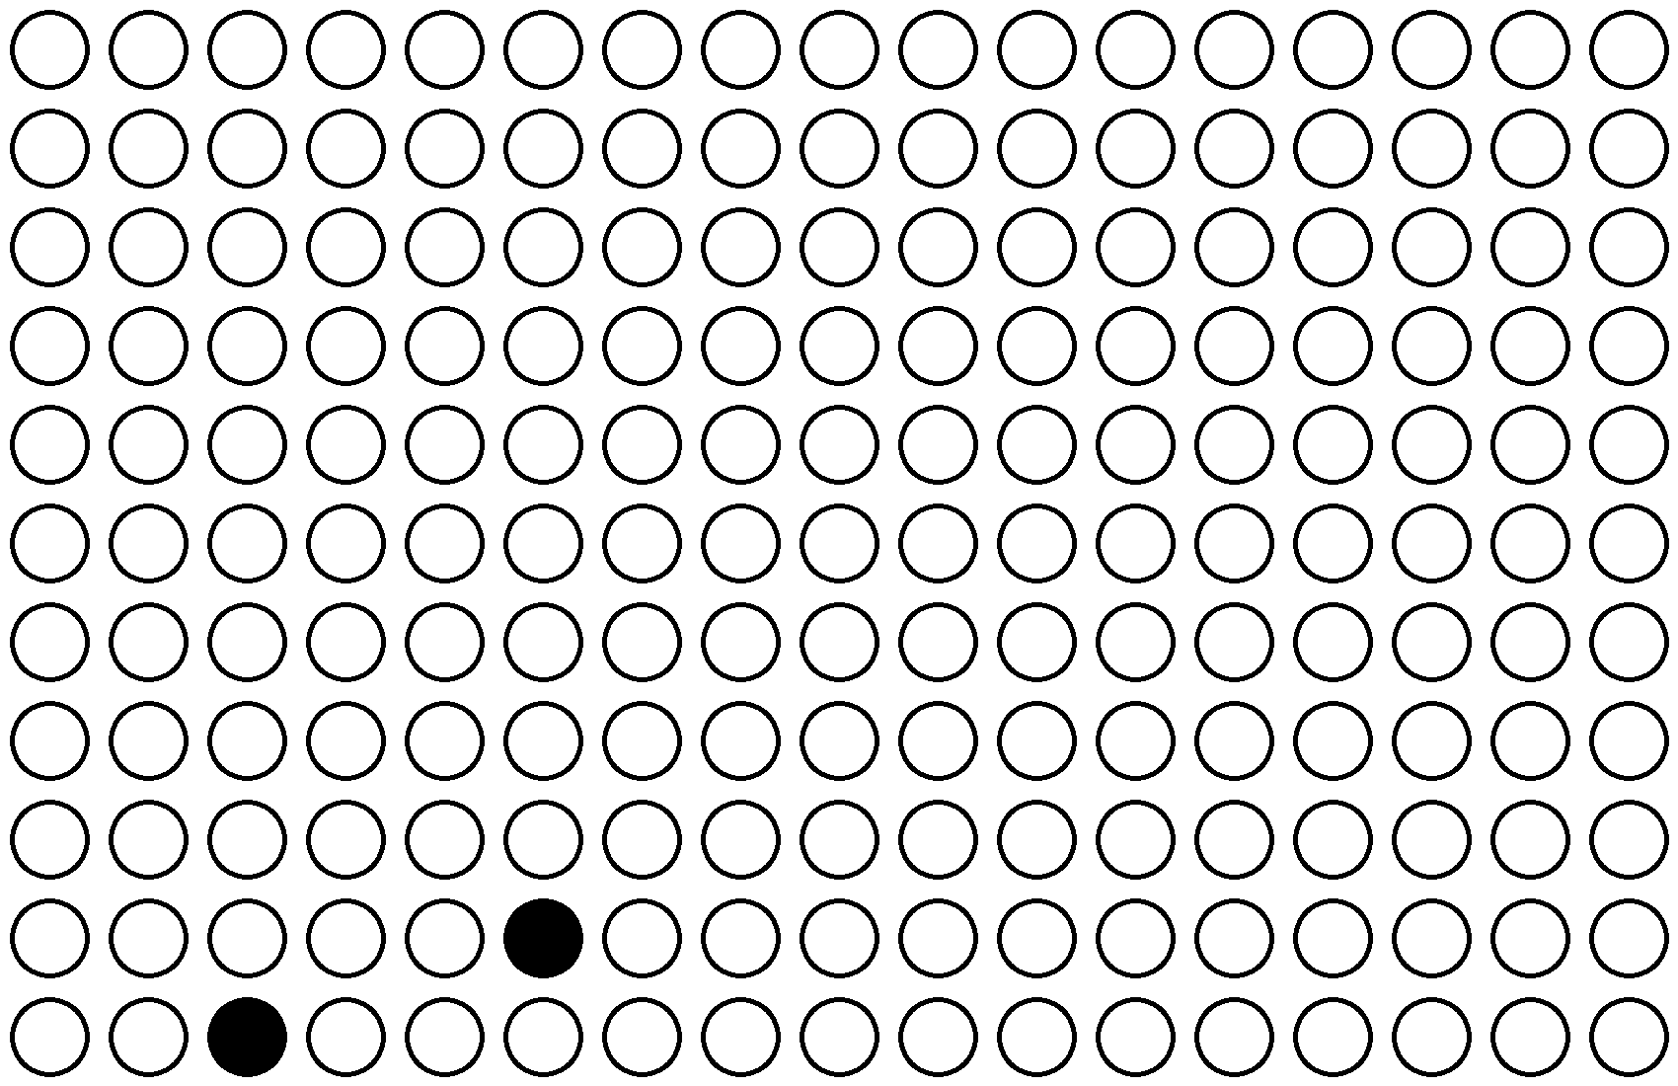

2-7 CAST Individual
050515
080415
051515
081015

Slide 8
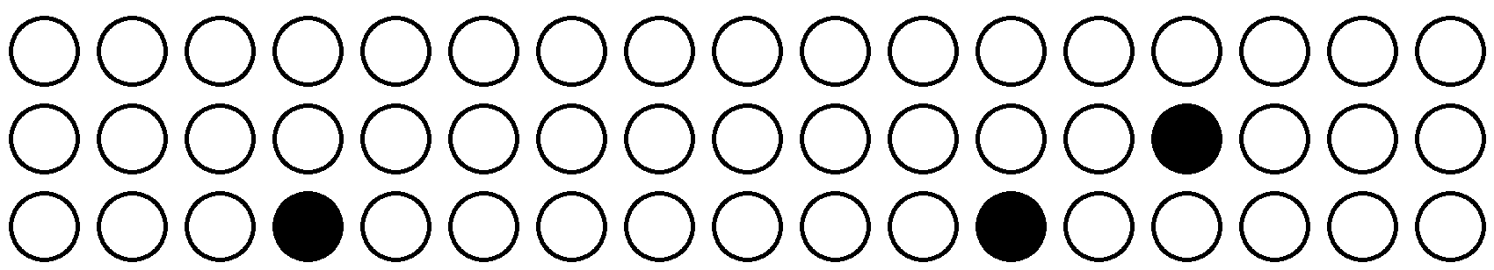

3-2
CAST COLONIES 050515
9CG B6 COLONIES 050515

Slide 9
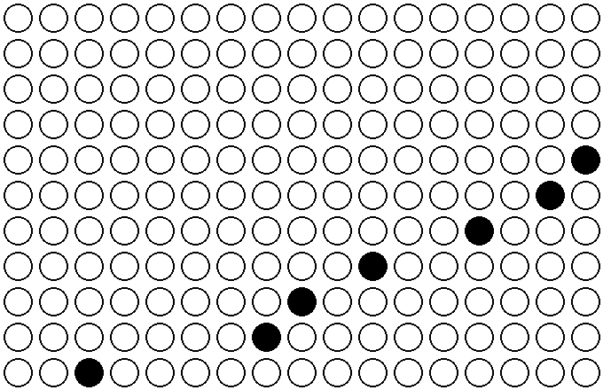
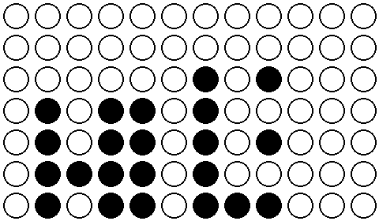
3-3
CAST COLONIES 050515, 051515,
080415, 081015
9CG B6 COLONIES 051515,
080415, 081015

Slide 10
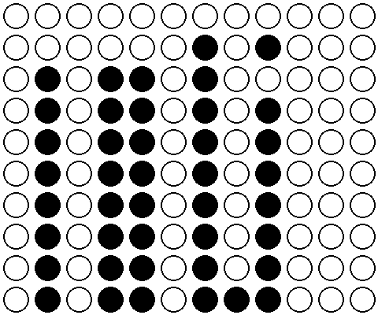

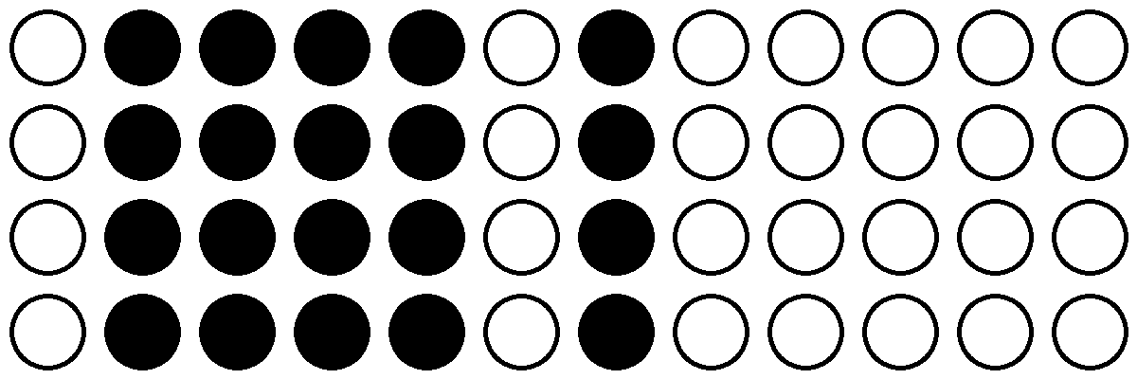
3-3 9CG B6 Individual
051515
081015
080415

Slide 11
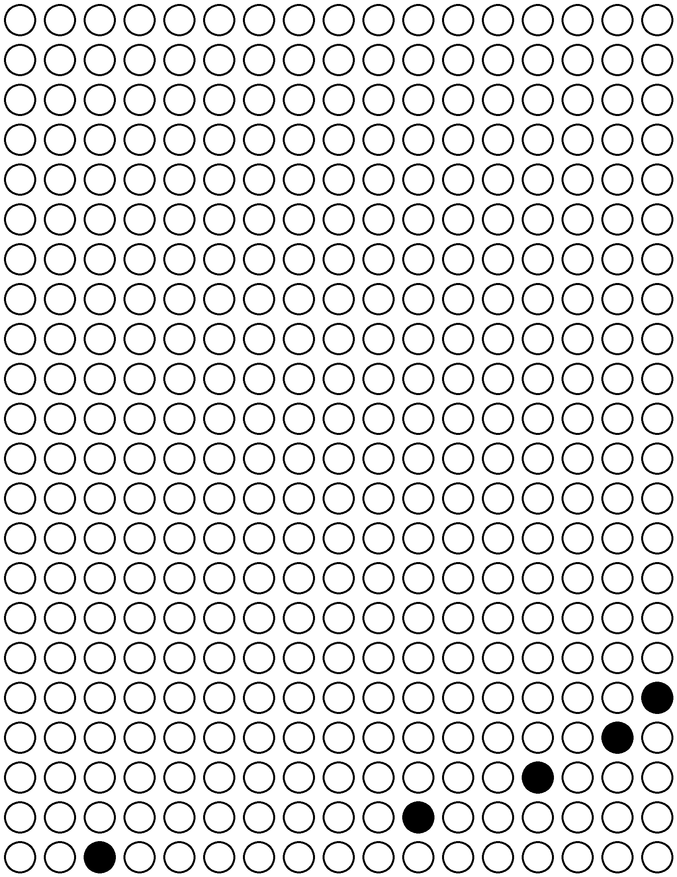
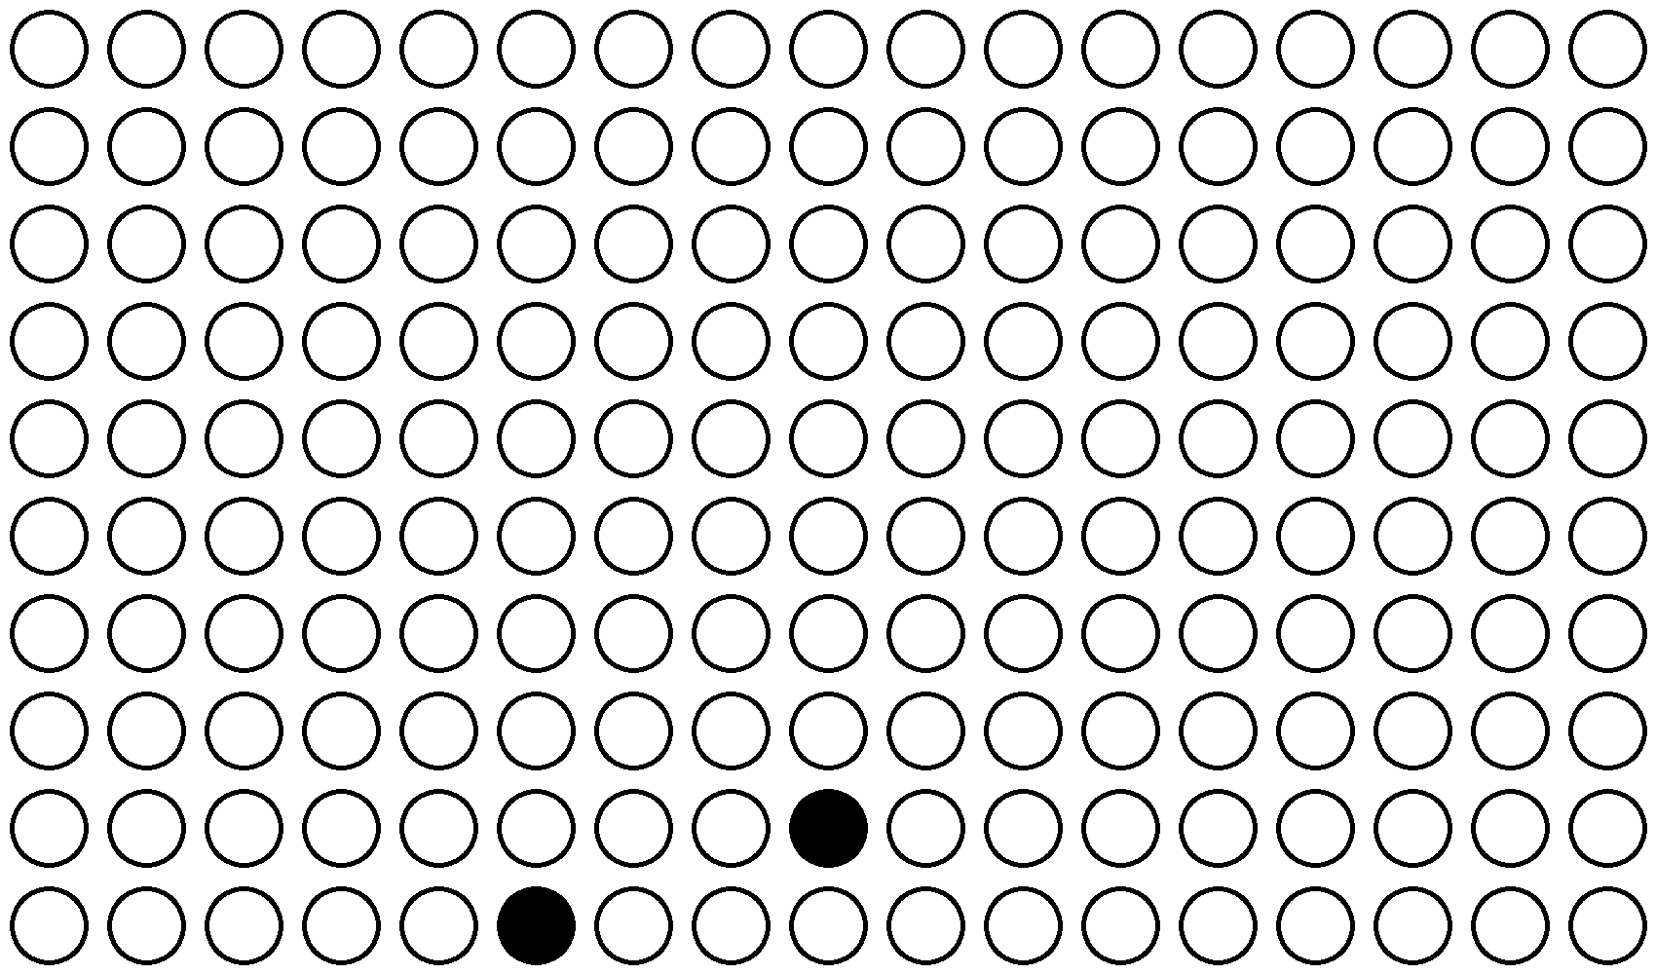


3-3 CAST Individual
050515
051515
080415
081015

Slide 12
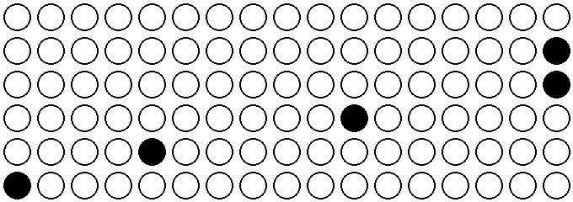
3-7
CAST COLONIES 050515
9CG B6 COLONIES 050515

Slide 13
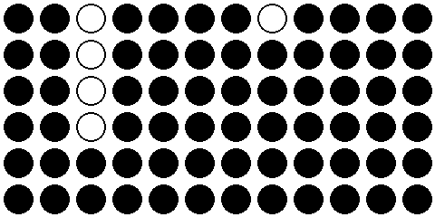
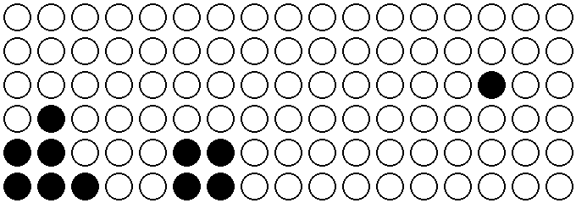
3-8
9CG B6 COLONIES 072215,
080415, 081015
CAST COLONIES 072215,
080415

Slide 14



3-8 9CG B6 Colonies
072215
080415
081015

Slide 15
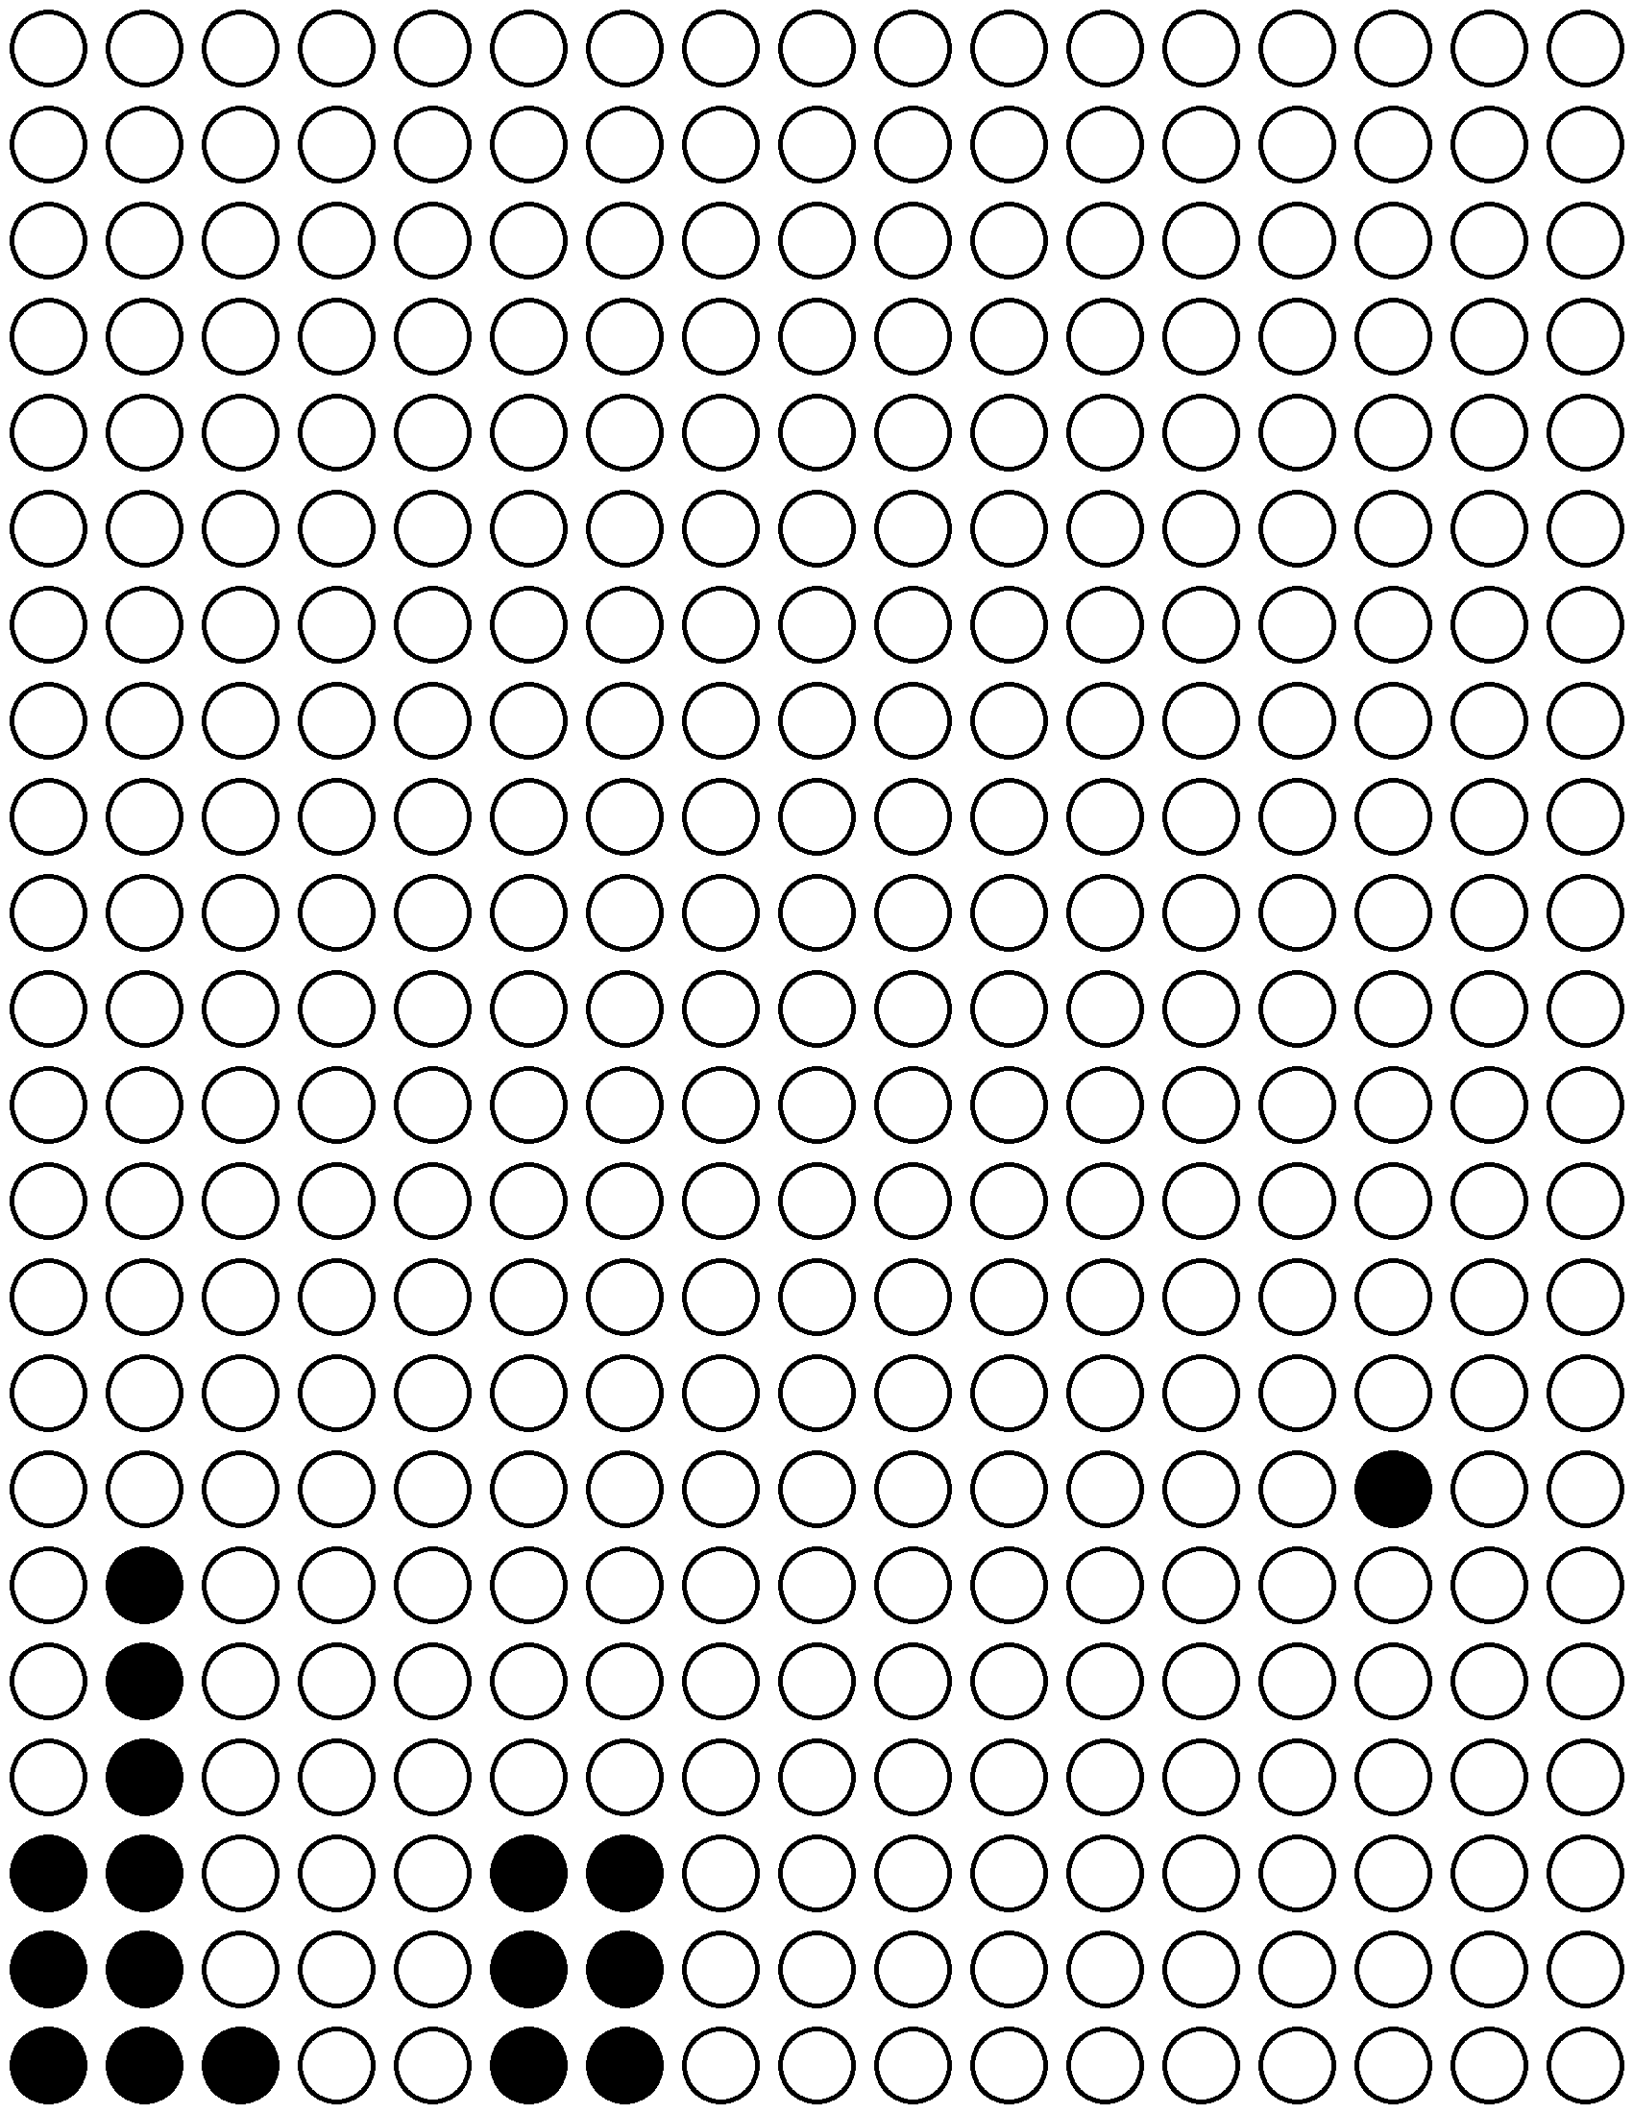
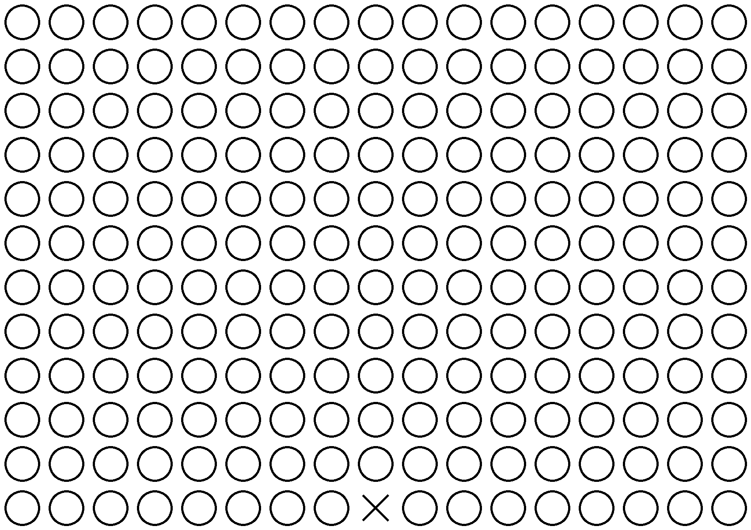
3-8 CAST Colonies
072215
080415

Slide 16
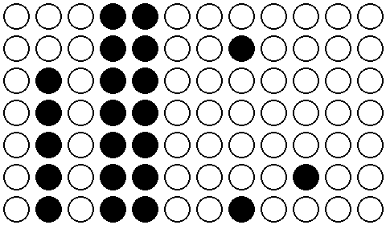
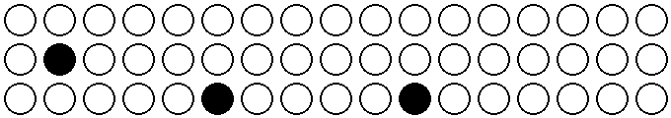
5-3
9CG B6 COLONIES 080415
CAST COLONIES 061015,
080415, 081015

Slide 17
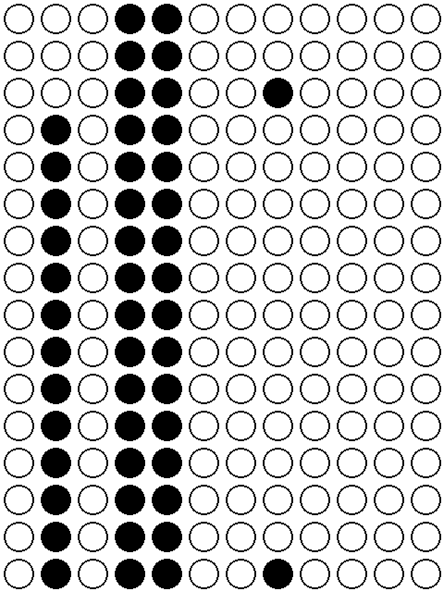
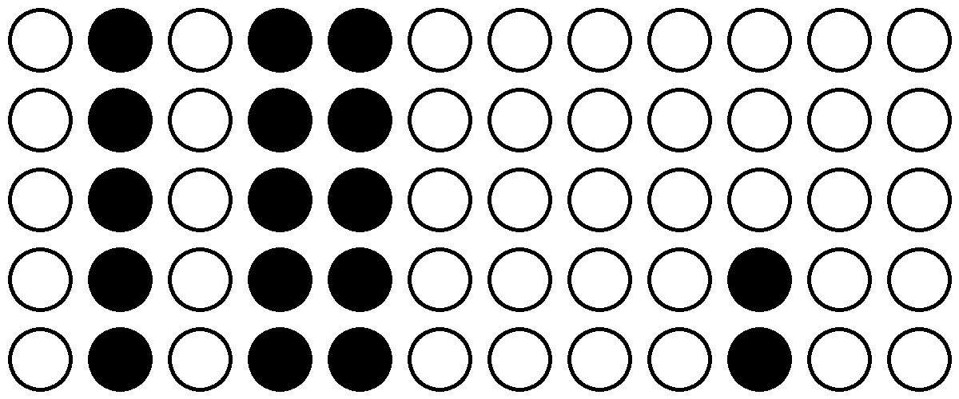

5-3 9CG B6 Colonies
061015
080415
081015

Slide 18

5-3 CAST Colonies
080415

Slide 19
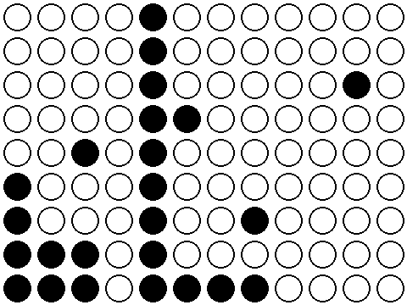
6-3
9CG B6 COLONIES 062215,
080415, 081015
CAST COLONIES 081015

Slide 20
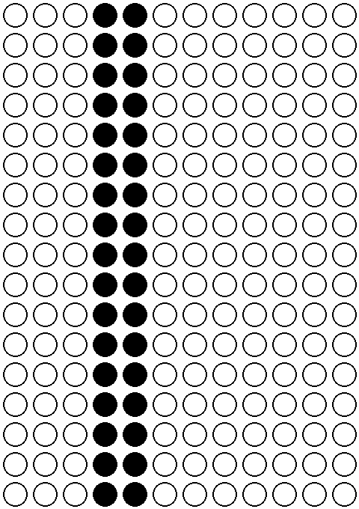
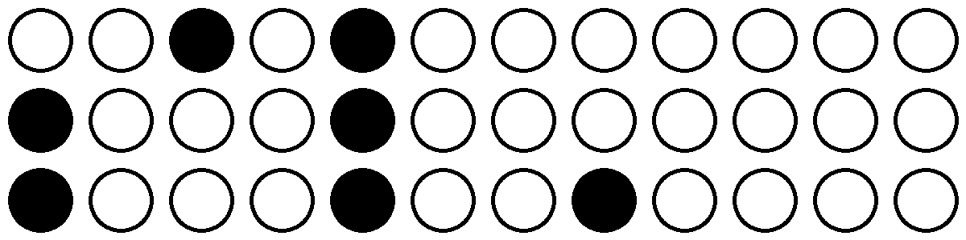

6-3 9CG B6 Colonies
062215
080415
081015

Slide 21

6-3 CAST Colonies
081015

Slide 22
6-7
9CG B6 COLONIES 072215

Slide 23
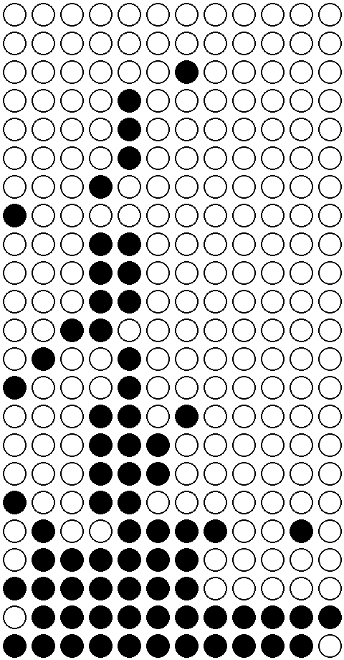
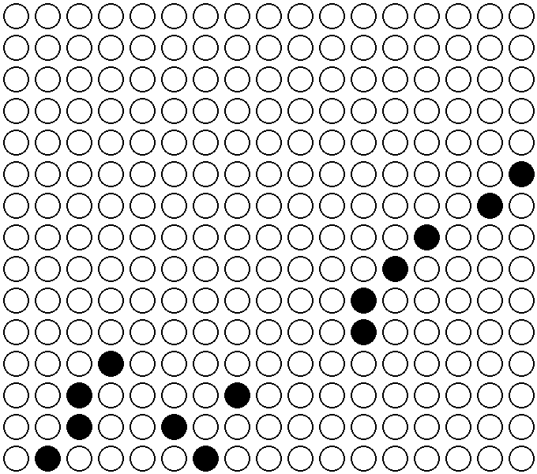
F2
9CG B6 COLONIES 050515,
051515, 080415, 081015
CAST COLONIES 050515, 051515, 080415,
081015

Slide 24
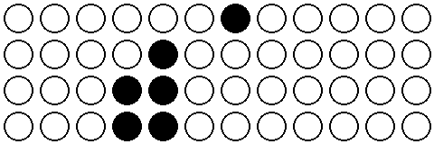
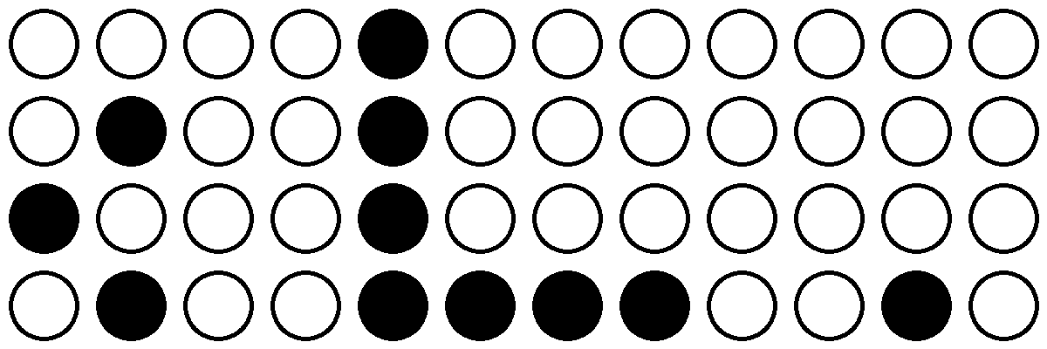
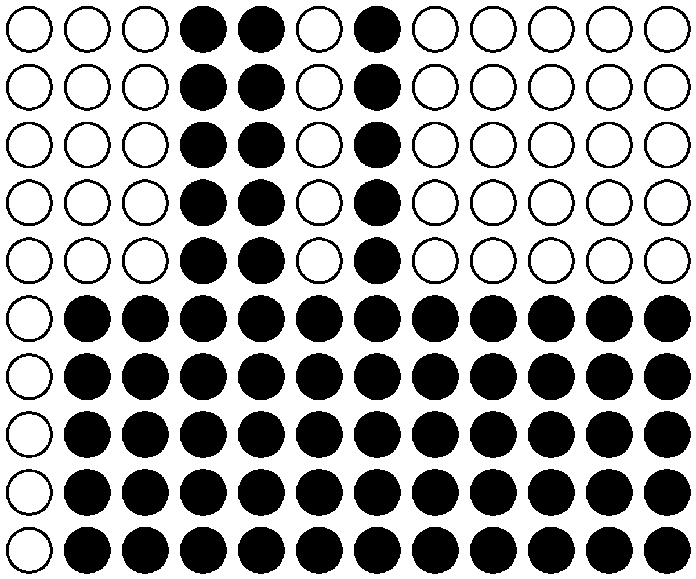
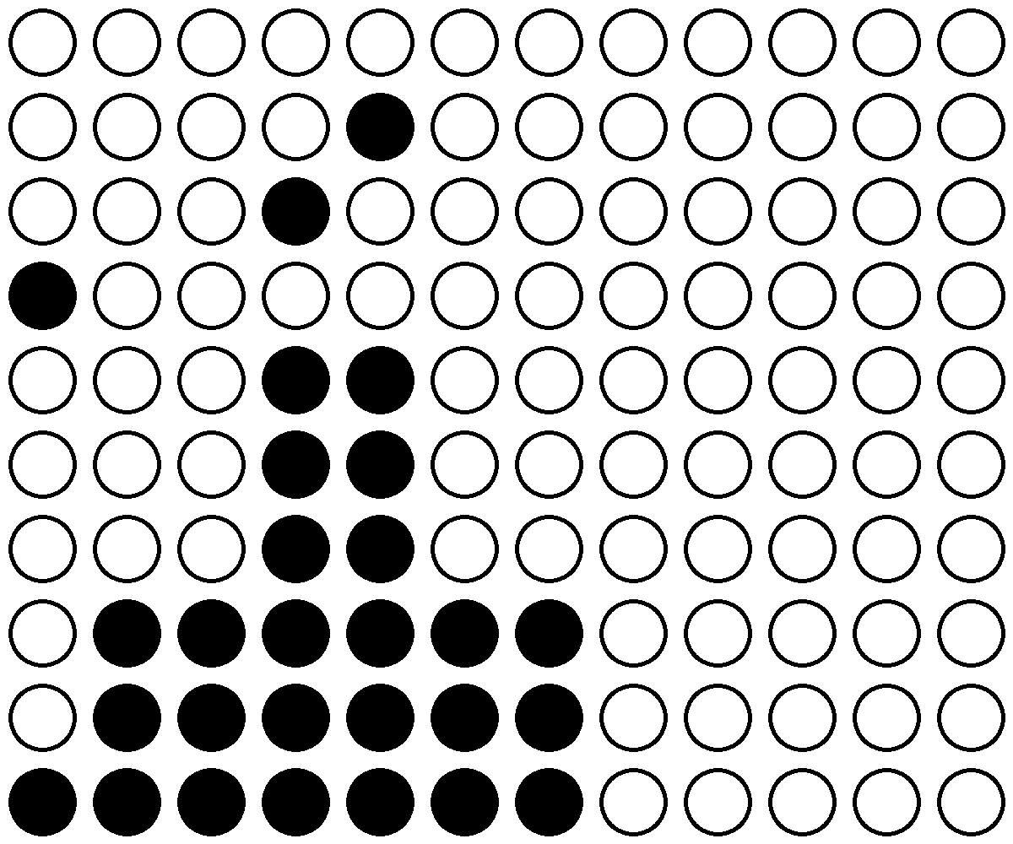
F2 9CG B6 Colonies
050515
080415
051515
081015

Slide 25

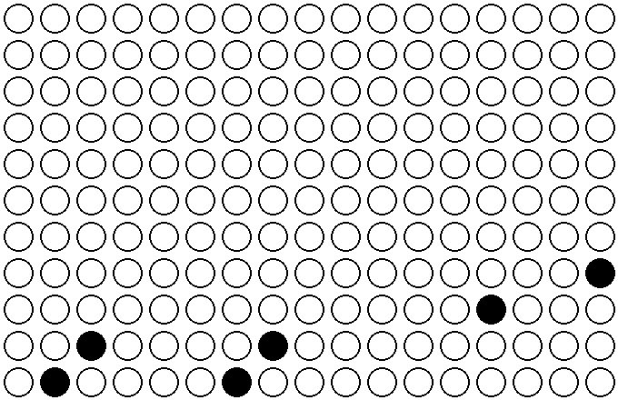

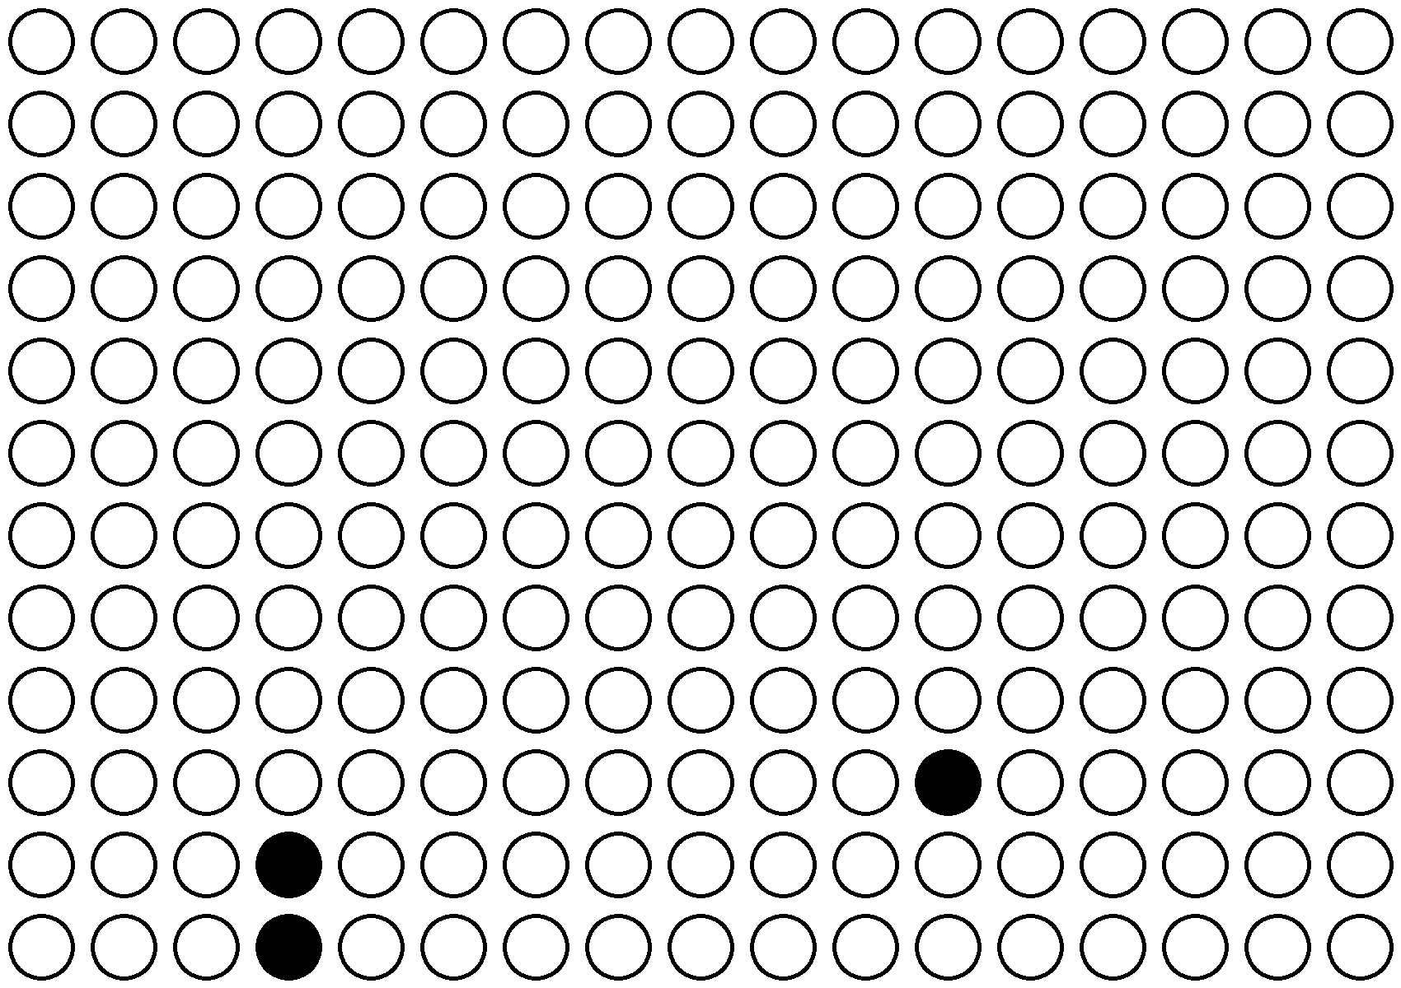
F2 CAST Colonies
050515
051515
080415
081015

Slide 26
9CG B6 COLONIES
F2
1-6
3-2
2-7
3-7
3-8
6-7
3-3
6-3
5-3

Slide 27
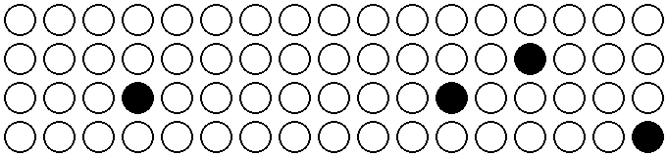
CAST Colonies
1-3
3-7
F2
1-6
2-7
3-8
5-3
6-3
3-3

